Slide 1
October 2023
crestviewstrategy.com
Community Engagement
Robinson Huron Treaty Settlement

Slide 2
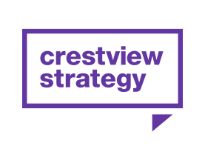
Introductions

Slide 3
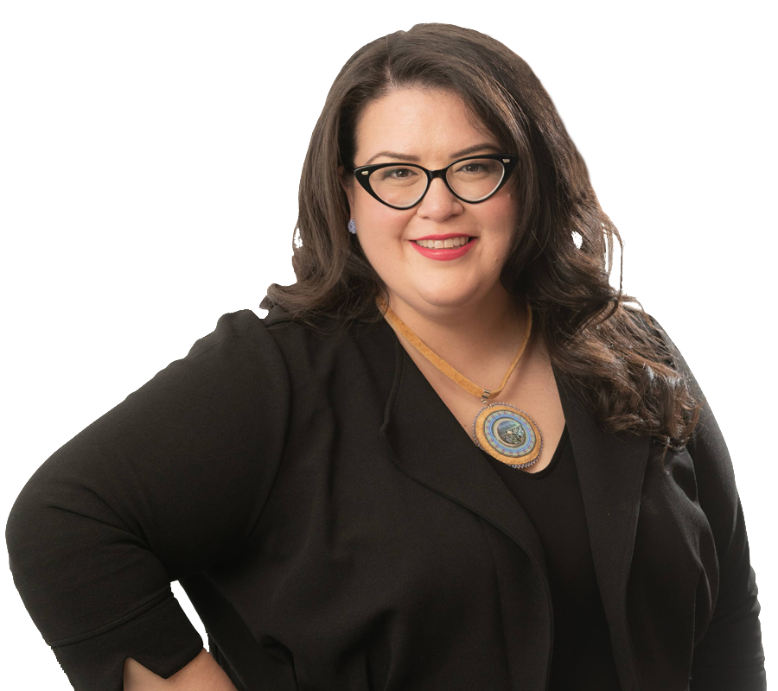
More about your team. Karen Restoule
Daughter, Sister, Auntie
Proud member of Dokis First Nation
Vice President at Crestview Strategy
Areas of specialty: Community engagement, strategy, and communications.
More than 20 years working with First Nations peoples and communities to advance solutions to legacy challenges: sovereignty, justice, public safety, victims of crime, corrections, women and girls, land and water, Indigenous laws and governance.
Led Ontario's administrative justice system at Tribunals Ontario, including Ontario Parole Board, Human Rights Tribunal Ontario, and Landlord and Tenant Board.
Co-founded BOLD Realities, to advance economic reconciliation and co-launch www.whose.land, a web-based mobile app that provides users with information about Indigenous territories.
Graduated from the University of Toronto (BA) and the University of Ottawa’s Faculty of Law (JD).
Contributing writer at thehub.ca
Notes:
Centre aligned for simple name and title, left aligned for longer caption

Slide 4
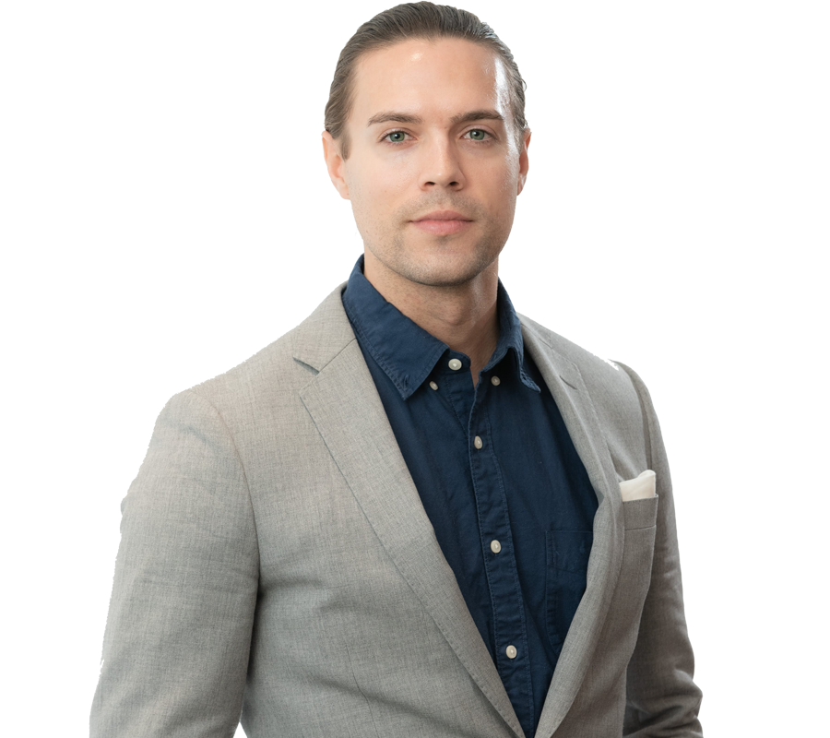
More about your team. Jordan Hudyma
Jordan Hudyma is a Campaign Strategist with Crestview Strategy based Toronto.
Jordan believes that every challenge represents a potential opportunity and thrives in demanding environments. Backed by over seven years in political campaign and communications expertise in both public and regulatory sectors, he has a proven track record of understanding what drives government decision-making and delivering campaign strategy.
Before joining the Crestview Strategy team, Jordan spent time working at Queen’s Park in the Ministry of Advanced Education and Skills Development and the Law Society of Ontario. He has also worked on a number of political campaigns at the provincial and municipal level with an area expertise in the Norther Ontario.
Jordan currently sits as community board member at the College of Audiologists and Speech Language Pathologists, and volunteers for multiple organizations including Big Brother Big Sister Toronto and remains involved with the Ontario Liberal Party.
Originally from Thunder Bay, Jordan still maintains deep roots in the North and often travels northwestern and northeastern Ontario.

Slide 5
Crestview Strategy
Crestview Strategy is an international public affairs agency with more than 110 consultants. Working from our offices in Vancouver, Calgary, Edmonton, Ottawa, Toronto, Halifax, Washington, D.C., and London, U.K., our team of subject matter experts and seasoned professionals have worked with multi-national corporations, associations, and not-for-profit organizations alike in helping them achieve their public affairs objectives.
Crestview Strategy is a full-service agency. In our client engagements, we often build cross-functional teams drawn from four separate practice areas, tailoring our team to meet your unique challenges. Our practice areas include Government Relations, Campaigns and Mobilization, Strategic Communications, and Insight and Research.

Slide 6
A full-service agency
1
Government relations The Government Relations practice at Crestview Strategy is driven to mitigate risk and uncover opportunities for clients.
3
Mobilization Crestview Strategy’s Mobilization practice identifies, targets, and mobilizes authentic citizens - propelling them to speak out on public affairs issues, engage in grassroots advocacy and build overall awareness.
2
Strategic communications We build and execute programs that lead specific audiences to understand and support our client objectives.
4
Research and insights Crestview Strategy designs and executes deliberative research programs that inform and provide insight into clients’ most critical decisions.
2
Creative services The Creative Services practice at Crestview Strategy develops creative content across all media and social platforms to ensure your message gains audiences' attention.

Slide 7
Overview of Activities
2nd in-person community engagement session in Dokis First Nation
In-person community engagement session in Sudbury
In-person community engagement session in North Bay
1st in-person community session in Dokis First Nation
4th in-person community engagement session in Dokis First Nation
October
November
December
January
February
Electronic engagement initiated
3rd in-person community engagement session in Dokis First Nation
In-person community engagement session (TBD)
Final community engagements
Electronic engagement closed

Slide 8
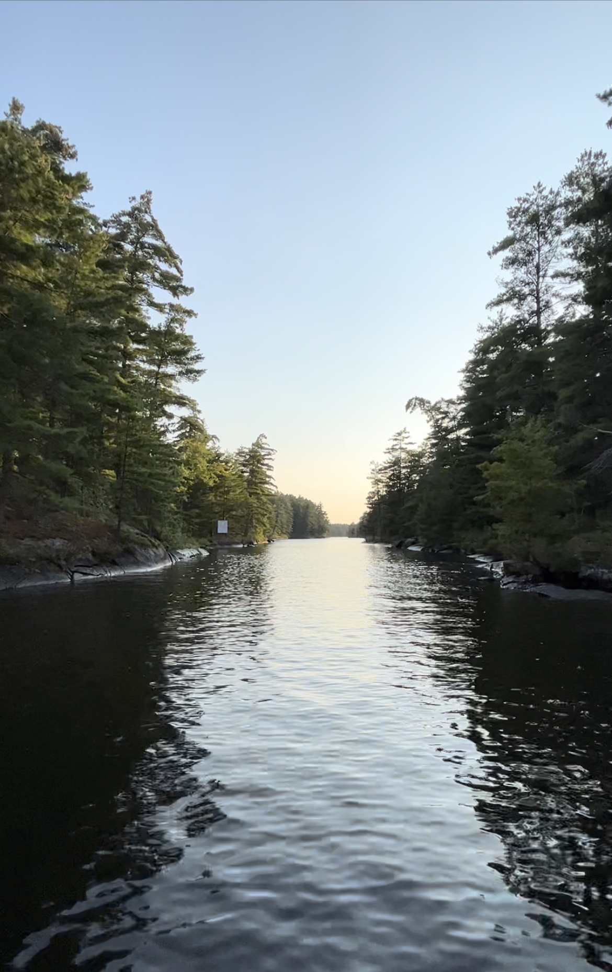
Miigwech!
Thank you!

